Slide 1
2022 MPFS Proposed Rule
August 10, 2021

Slide 2
Kayley Jaquet
Manager of Regulatory Affairs

Slide 3
Agenda
Fee Schedule
AUC/CDS
Telehealth
Evaluation and Management (E/M) Coding
Scope of Practice
Quality Payment Program (QPP)
Merit-Based Incentive Program (MIPs)
Updates
MVPs

Slide 4
Fee Schedule

Slide 5
Fee Schedule
Proposed Conversion Factor - $33.58
Decrease of - $1.31 from 2021 CF of $34.89
Anesthesia Factor - $21.04
Decrease of - $.52 from 2021 CF of $21.56

Slide 6
Fee Schedule
Why is this happening?
Consolidated Appropriations Act of 2021 temporarily increased the fee schedule by +3.75% for 2021 only
Budget Neutrality
‘Misvalued Code’ initiative
Clinical Labor Pricing update
Both programs result in impacts to the PE RVU for 2022
Notes:
The statutory update to the fee schedule is set at 0.0 from 2020-2025 – so this adjustment is due to budget neutrality and RVU changes

Slide 7
Fee Schedule – Impact by Specialty
Specialty | Impact
Interventional Radiology | -5%
Radiation Oncology | -2%
Radiology | -1%
Physical/Occupational Therapy | -1%
Nuclear Medicine | -1%
General Surgery | 0%
Pathology | 0%
Gastroenterology | 0%
Physician Assistant | 0%
Allergy/Immunology | 0%
Family Practice | 1%
Anesthesiology | 1%
Nurse Anes. / Anes. Assistants | 1%
Endocrinology | 1%
Orthopedic Surgery | 1%
Hand Surgery | 1%
Dermatology | 1%
Podiatry | 1%
Diagnostic Testing Facility | 5%
Full impact table available pg 460 of rule

Slide 8
Appropriate Use Criteria/Clinical Decision Support (AUC/CDS)

Slide 9
AUC/CDS
2014 PAMA Mandate requires CMS to create regulations requiring ordering providers to consult appropriate use criteria when ordering advanced imaging studies for Medicare beneficiaries.
MRIs/MRAs, CTs, PET, Nuclear Medicine
Ordering providers must pass along AUC data (modifiers and g-codes) to furnishing providers to append to claims
Program currently in an extended operations and testing phase until January 1st, 2022
CMS proposing to delay the penalty phase of the program until January 1st, 2023

Slide 10
AUC/CDS
Critical Access Hospitals
CMS is proposing to use the MH modifier to identify scenarios where the AUC mandate is not applicable due to the applicable payment setting provisions of the rule
AUC mandate applies to Medicare beneficiaries who are seen in an outpatient setting (including the ER) and paid for under the MPFS, HOPPS, or ASC payment systems
This is different than the approved hardships of the program
MH modifier is currently used to report ‘unknown if ordering provider consulted AUC’
Medicare as Secondary Payor
CMS is clarifying that AUC mandate will not apply to beneficiaries with Medicare as secondary insurance
This is a reversal of earlier guidance

Slide 11
AUC/CDS
Modifier | Description
MA | Ordering professional not required to consult a CDSM due to patient having a suspected or confirmed medical emergency
MB | Ordering professional is not required to consult a CDSM due to the significant hardship exception of insufficient internet access
MC | Ordering professional is not required to consult a CDSM due to the significant hardship exception of EHR or CDSM vendor issues
MD | Ordering professional is not required to consult a CDSM due to the significant hardship exception of extreme and uncontrollable circumstances
ME | The order adheres to the appropriate use criteria in the CDSM consulted by the ordering professional
MF | The order does not adhere to the appropriate use criteria in the CDSM consulted by the ordering professional
MG | The order for this service does not have appropriate use criteria in the CDSM consulted by the ordering professional
MH | **Repurposed for CAH if finalized** Unknown if ordering professional consulted a CDSM for this service, related information was not provided to the furnishing professional or provider

Slide 12
AUC/CDS
Implementation Considerations
Plan around the delay, make the most of extension
Keep going!
More time to analyze data, looks for trends, make adjustments
Keep in mind, PAMA is law – it would take congressional action to toss out AUC altogether
Industry groups calling for rework or repeal
Some attention being paid by House Ways and Means Committee

Slide 13
Telehealth

Slide 14
Telehealth
The COVID-19 PHE rapidly expanded telehealth utilization and access for Medicare beneficiaries, supported by temporary waivers available during the PHE.
CMS proposing to retain all services added to the Medicare telehealth services list on a Category 3 basis until the end of 2023.
CMS identifying which codes would leave list at end of current PHE
Looking for comments on the extension OR permanent adoption of direct physician supervision done via telehealth

Slide 15
Telehealth
CMS is proposing to cover audio-only communications technology when used for telehealth services for the diagnosis, evaluation, or treatment of mental health disorders for established patients.
Virtual Check Ins - Proposing to permanently adopt coding and payment for HCPCS code G2252
Brief communication technology-bases service, 11-20 minutes of medical discussion

Slide 16
Evaluation and Management (E/M) Coding

Slide 17
E/M Coding
CMS proposing rules around split/shared E/M billing
Shared billing would be allowed in facility type settings
POS 11 would not allow for billing shared services
Time would be used, instead of medical decision making, for code selection
Modifier would be used to report split/shared visit
Notes:
The 2021 CPT book added the concept of shared services, for E/M services provided jointly between a physician and other qualified health care professional. In May, CMS removed their manual sections for split/shared services, for critical care, and for skilled nursing services. They noted that they would address these issues in room making rule making, and they are doing so in this proposal rule.

Slide 18
Scope of Practice

Slide 19
Physician Assistants
CMS is proposing to allow Physician Assistants to bill Medicare directly effective January 1st, 2022
Congress removed the requirement for Medicare to reimburse the PA’s employer with the passage of the Consolidated Appropriations Act of 2021.
CMS is using this authority to authorize PAs to be paid directly for their services in the same way that NPs and CNSs are under Medicare

Slide 20
Quality Payment Program(QPP/MIPs)

Slide 21
MIPS Program Updates
2021 Program Flexibilities
Complex Patient Bonus
Max of 10 pts towards total score
Proposing a permanent expansion and change to HCC calculation method for 2022
COVID-19 hardship application
Open until end of 2021
Apply through QPP.cms.gov portal

Slide 22
MIPS Program Updates
2022 Performance Year Proposals
Penalty threshold – 75 pts
Up from 60 pts for the 2021 PY
Performance Category Weights
Quality – 30% (- 10%)
Cost – 30% (+ 10%)
Improvement Activities – 15%
Promoting Interoperability – 25%
No changes to program eligibility or maximum payment adjustments

Slide 23
MIPS Program Updates
Historical Performance Year Thresholds
Performance Year | Payment Year | Max Payment Adjustments | Performance Threshold | Exceptional Performance Threshold | Payment Adjustments
2017 | 2019 | (+/ - ) 4% | 3 pts | 70 pts | 1.88%
2018 | 2020 | (+/ - ) 5% | 15 pts | 70 pts | 1.68%
2019 | 2021 | (+/ - ) 7% | 30 pts | 75 pts | 1.79% 4.67% **
2020 | 2022 | (+/ - ) 9% | 45 pts | 85 pts | 2.20% 6.25% **
2021 | 2023 | (+/ - ) 9% | 60 pts | 85 pts | 6 – 8 % **
2022 | 2024 | (+/ - ) 9% | 75 pts | 89 pts | 8+%**
2023 | 2025 | (+/ - ) 9% | TBD | N/A | 8+%**
**CMS forecast

Slide 24
MIPS Program Updates
Special Statuses:
Small Practices (15 or fewer clinicians) to be added to list of clinician types exempt from the Promoting Interoperability category
If NOT scored on cost, MIPS score would be 50% Improvement Activities, 50% Quality
Program Eligibility:
Proposing to add clinical social workers and certified nurse midwives to list of MIPS eligible clinician types

Slide 25
MIPS Program Updates
Quality Category Proposals
Data Completeness threshold increase to 80%
Up from 70%
Data completeness is the required percentage of MIPs reporting on the applicable population for a quality measure
Measures under data completeness threshold return fewer points
Removal of measure related bonus points
Outcome Bonus - 2 bonus points will be given for each additional outcome or patient experience measure reported
High Priority Bonus - 1 bonus points will be given for each additional high priority measure reported
End-to-end Bonus - 1 point given for each measure that’s collected in 2015 Edition CEHRT and submitted to CMS without manual manipulation

Slide 26
MIPS Program Updates
Quality Category Proposals
Removal of 3-point floor
Except for Small Practices
Measures with a benchmark (and DC and case minimum) to earn between 1-10 points
Measures with NO benchmark or under DC or under case minimum to earn 0 points
Addition of 5-point floor for NEW measures
Measures NEW to MIPs would earn a minimum of 5 points during first two performance periods
If benchmarked, measures would return between 5-10 points once DC and case minimum is met

Slide 27
MIPS Program Updates
Selection of Quality Measure Proposed for Removal
21 | Selection of Prophylactic Antibiotic
23 | VTE Prophylaxis
137 | Melanoma: Continuity of Care – Recall System
144 | Medical and Radiation - Plan of Care for Pain
195 | Carotid Artery Stenosis Measurement
225 | Mammography Reminder System
317 | Screening for High Blood Pressure and Follow-Up Documented
337 | Psoriasis: Tuberculosis (TB) Prevention for Patients with Psoriasis
Notes:
Here are the measures CMS is proposing to remove.

Slide 28
MIPS Program Updates
Quality Category Proposals
Proposing the addition of 5 new quality measures
2 Administration Claims Based
Risk-Standardized Acute Unplanned Cardiovascular- Related Admission Rates for Patients with Heart Failure
Clinician and Clinician Group Risk-standardized Hospital Admission Rates for Patients with Multiple Chronic Conditions
For groups of 16 + clinicians
3 Reportable Measures
Intravesical Bacillus Calmette-Guerin (BCG) for non-muscle Invasive Bladder Cancer – eCQM reporting
Hemodialysis Vascular Access: Long term care rate – MIPS CQM (registry) reporting
Person-Centered Primary Care Measure Patient Reported Outcome Performance Measure – MIPS CQM (registry) reporting
Seeking comments on COVID vaccine rate measure

Slide 29
MIPS Program Updates
Cost Category Proposals
Proposing the addition of 5 new episode-based cost measures
Melanoma Resection
Colon and Rectal Resection
Sepsis
Diabetes
Asthma/Chronic Obstructive Pulmonary Disease [COPD]
If finalized, these measures would be added to the current list of 18 episode-based measures
CMS proposing a process for external Cost measure development
Call for measures to be added in the 2024 performance year

Slide 30
MIPS Program Updates
Improvement Activity Proposals
Proposing adjustments to criteria for nominating new activities
CMS would have the ability to suspend Improvement Activities during a performance period
In the case that patient care is at risk due to the activity
7 new activities proposed, 6 current activities proposed for removal:
IA_BE_13 | IA_BE_18
IA_PSPA_11 | IA_BE_20
IA_BE_17 | IA_BE_21

Slide 31
MIPS Program Updates
Promoting Interoperability Category Proposals
Public Health and Clinical Data Exchange Objective
Participants would be required to report the Immunization Registry Reporting and Electronic Case Reporting measures unless an exclusion can be claimed
CMS proposing to make the three other measures within this section as optional to report in addition to the two required
Attestations
Modified Information Blocking to distinguish between the OIG Information Blocking Rules
Participants required to attest to conducting risk assessments under Safety Assurance Factors for EHR Resilience Guides (SAFER Guides)
Provide Patients Electronic Access measure
Modifying to add January 1st, 2016 as the required date for patient access

Slide 32
MIPs Value Pathways (MVPs)

Slide 33
MIPS Value Pathways
CMS is proposing 7 MVPS to be available for reporting beginning 2023
Rheumatology
Stroke Care and Prevention
Heart Disease
Chronic Disease Management
Emergency Medicine
Lower Extremity Joint Repair
Anesthesia
MVPs – condition or specialty-specific groups of cost, quality and improvement measures with a foundation of the promoting interoperability category.

Slide 34
MIPS Value Pathways
CMS intends MVPs to be the future of MIPS reporting, seeking comment on the sunset of traditional MIPS with the end of the 2027 performance period
How are MVPs different than MIPS?
Clinicians select from a smaller list of measures or activities
Clinicians will register to report an MVP during the performance year
Between April 1st – November 30th
MVPs require less data submission than traditional MIPS
CMS calculates administrative claims and Cost measures
MVPs require fewer quality measures

Slide 35
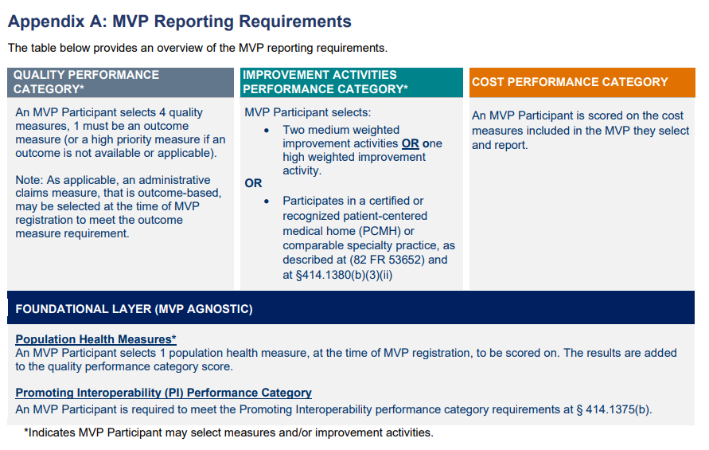
MIPS Value Pathways

Slide 36
MIPS Value Pathways
Proposed MVP Participation Options
2023 - 2024 performance years | 2025 performance year and beyond
Individual clinicians Single specialty groups Multispecialty groups* Subgroups APM Entities | Individual clinicians Single specialty groups Subgroups APM Entities
Opt-in or Voluntary eligible providers would not be able to report MVPs at first | Multispecialty groups MUST report via subgroups

Slide 37
Comment Period and Final Rule
Comments on the proposed rule are open until September 13th
CLICK HERE for the 2022 Proposed Rule on the Federal Register
Final rule is anticipated Nov/Dec

Slide 38
Questions?
Kayley.Jaquet@advocatercm.com

Slide 39
Thank you!

